Slide 1




Bioinformatics Basics
Rapid Response – Revised Feb 2025

Slide 2
Outline
Review NGS workflow
  Whole genome sequencing (WGS) vs metagenomic NGS (mNGS)
Sequence File Formats
  FASTA vs FASTQ
Pipeline basics
  WGS workflow overview
  mNGS common workflow steps
BLAST

Slide 3
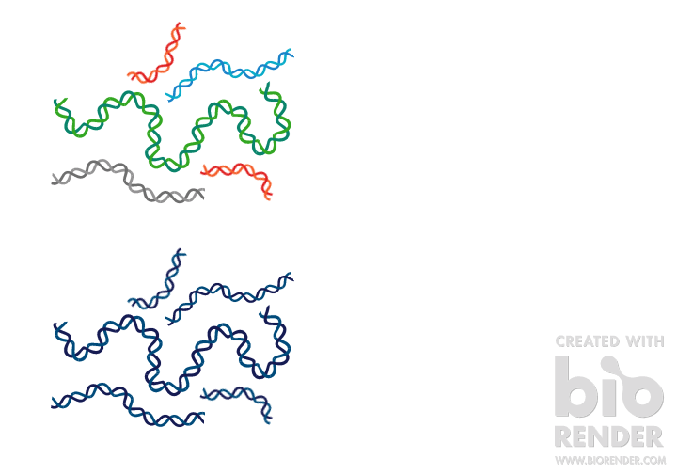
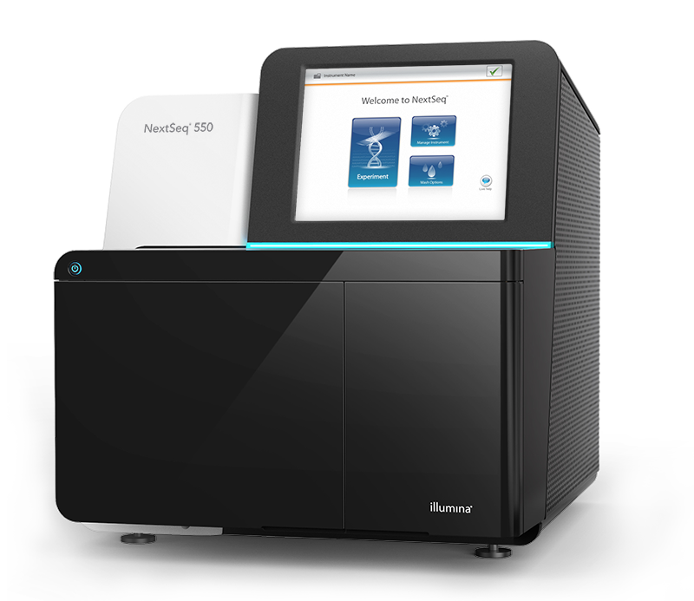
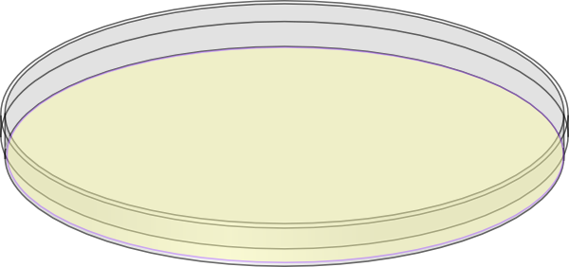
WGS vs mNGS Workflow
Sample Collection
DNA or RNA Extraction
Library
Preparation
Sequencing
Bioinformatic Analysis
Genome Assembly
Variant Analysis
WGS

Slide 4


WGS vs mNGS Workflow Overview
Sample Collection
DNA or RNA Extraction
Library
Preparation
Sequencing
Bioinformatic Analysis
Genome Assembly
Variant Analysis
WGS
Taxonomic Identification
Microbiome analysis
Discovery
mNGS

Slide 5
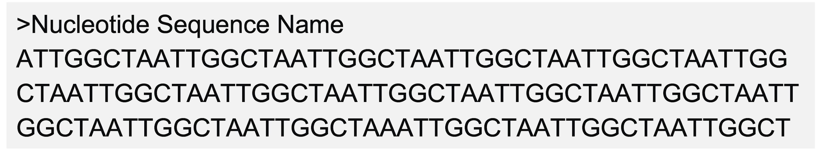
Sequence File Format: FASTA vs FASTQ
FASTA
  Includes sequence name and sequence
Sequence Identifier
Sequence

Slide 6
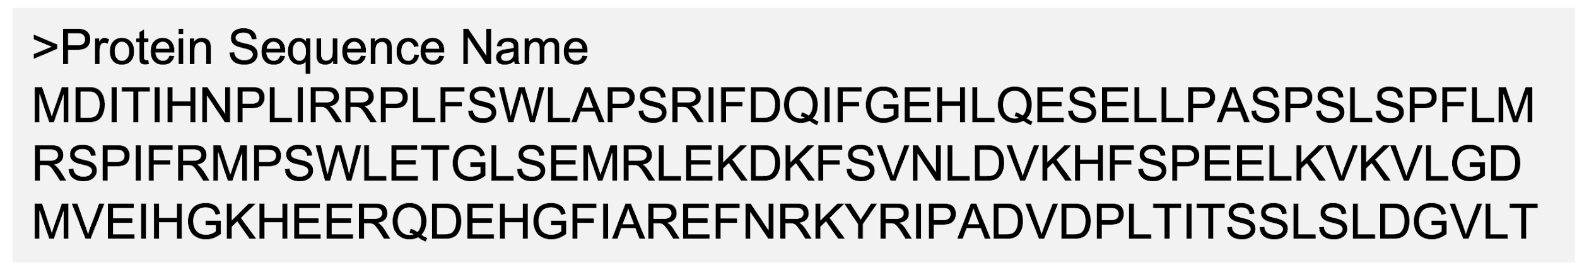
Sequence File Format: FASTA vs FASTQ
FASTA
  Includes sequence name and sequence
Sequence Identifier
Sequence

Slide 7
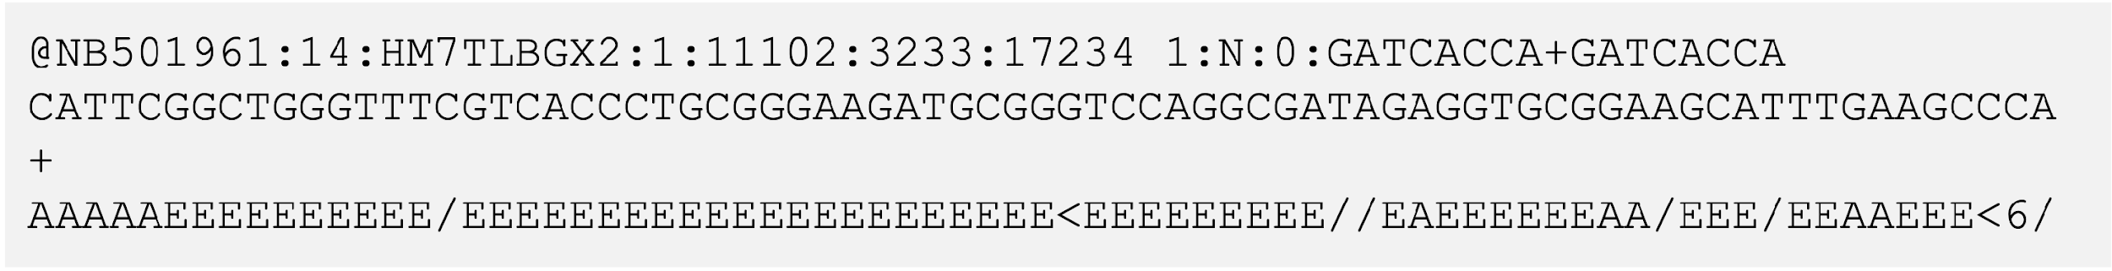
Sequence File Format: FASTA vs FASTQ
FASTA
  Includes sequence name and sequence
FASTQ
  Includes sequence identifier, sequence, and quality scores for base calls
Sequence Identifier
Sequence

Slide 8
Raw Sequence Reads: FASTQ format
Example Read
@NB501961:14:HM7TLBGX2:1:11102:3233:17234 1:N:0:GATCACCA+GATCACCA
CATTCGGCTGGGTTTCGTCACCCTGCGGGAAGATGCGGGTCCAGGCGATAGAGGTGCGGAAGCATTTGAAGCCCA
+
AAAAAEEEEEEEEEE/EEEEEEEEEEEEEEEEEEEEEE<EEEEEEEEE//EAEEEEEEAA/EEE/EEAAEEE<6/
Quality Score | Probability of Incorrect Base Call | Inferred Base Call Accuracy
10 (Q10) | 1 in 10 = 10% | 90%
20 (Q20) | 1 in 100 = 1% | 99%
30 (Q30) | 1 in 1000 = 0.1% | 99.9%
A sequence identifier with information about the run.
The base calls: A, C, T, G and N.
A separator, which is simply a plus (+) sign.
The base call quality scores or Phred scores (coded in ASCII format)
Q = -10log₁₀(e)
Notes:
@<instrument>:<run number>:<flowcell ID>:<lane>:<tile>:<x-pos>:<y-pos> <read>:<is filtered>:<control number>:<sample number>

Slide 9

How many reads are listed here?
File: Sample_R1.fastq
@NB501961:14:HM7TLBGX2:1:11102:3233:17234 1:N:0:GATCACCA+GATCACCA
CATTCGGCTGGGTTTCGTCACCCTGCGGGAAGATGCGGGTCCAGGCGATAGAGGTGCGGAAGCATTTGAAGCCCATCTCGGCGATCAGTTTGATGTCTTCTTTGTAGCGACCGTAGAAGTCGACGGCTTCGTGGTTCGGGTAGTATTTTN
+
AAAAAEEEEEEEEEE/EEEEEEEEEEEEEEEEEEEEEE<EEEEEEEEE//EAEEEEEEAA/EEE/EEAAEEE<6/<AEE<E<A//EEEEEAEE<EA/<AA//EAAEAAE<E/EAEE///E<A/<AA//A<A<<A6<A//AA/E////6A#
@NB501961:14:HM7TLBGX2:1:11103:13923:13163 1:N:0:GATCACCA+GATCACCA
GAACTGGAGCTTTAGCCCGGTGATCCTGTGCCTCATTTGTATGGCTACCGCCATGGTGATGTACCTGCCATTTCTCAAAGCTTACGAAAAACAGCTGCTGGCCCAGGAGCGTGAAAACGCCGTCGGCCAGGCTGACAACGCGGCGCAGAN
+
AAAAAEEEEEEEEEEEEAEEEEEEEEEEEEEAEEEEEEEEEEEEEEEEEEE/EEEEEEAAAEAEAEEAEEAEEEEEEEEEEEEEEEAAEEEEEEEEEEEEEEA<EEEEEEEAE<AEAEEAA<AAEEAEEEAE/6/A/EEEE/EEE<AE/#
@NB501961:14:HM7TLBGX2:1:11104:15318:11334 1:N:0:GATCACCA+GATCACCA
GATAGTGCTGTTCGCGAGCGATCGCCAGTACGCGCTCGCGCGTCTCCTGCGCCACGCGCAGCTCTTTACCACGACCGTTGAGTACCAGGCTGGCGGTCGCTTTGGAGACGCCCGCCAGTTCGGCGATATCTTTGATAGTTACGCGTTTGG
+
AAAAAEEEEEEEAEEEAEEEEEEEEEEEEEEEEEEEEEEEEEEEEEEEEEEEEEEEEEEAEEAEE<EAEE/EE/EEE<AEEEE/EEEEEEEEEEEE/EEE//AEE<E/EEEEAEEA/E<<AEEEE/<66A///<</AA<//6AE<<6/<6
Notes:
How many reads are listed here?

Slide 10
How do we get from here...
sample_R1.fastq
@NB501961:14:HM7TLBGX2:1:11102:3233:17234 1:N:0:GATCACCA+GATCACCA
CATTCGGCTGGGTTTCGTCACCCTGCGGGAAGATGCGGGTCCAGGCGATAGAGGTGCGGAAGCATTTGAAGCCCATCTCGGCGATCAGTTTGATGTCTTCTTTGTAGCGACCGTAGAAGTCGACGGCTTCGTGGTTCGGGTAGTATTTTN
+
AAAAAEEEEEEEEEE/EEEEEEEEEEEEEEEEEEEEEE<EEEEEEEEE//EAEEEEEEAA/EEE/EEAAEEE<6/<AEE<E<A//EEEEEAEE<EA/<AA//EAAEAAE<E/EAEE///E<A/<AA//A<A<<A6<A//AA/E////6A#
@NB501961:14:HM7TLBGX2:1:11103:13923:13163 1:N:0:GATCACCA+GATCACCA
GAACTGGAGCTTTAGCCCGGTGATCCTGTGCCTCATTTGTATGGCTACCGCCATGGTGATGTACCTGCCATTTCTCAAAGCTTACGAAAAACAGCTGCTGGCCCAGGAGCGTGAAAACGCCGTCGGCCAGGCTGACAACGCGGCGCAGAN
+
AAAAAEEEEEEEEEEEEAEEEEEEEEEEEEEAEEEEEEEEEEEEEEEEEEE/EEEEEEAAAEAEAEEAEEAEEEEEEEEEEEEEEEAAEEEEEEEEEEEEEEA<EEEEEEEAE<AEAEEAA<AAEEAEEEAE/6/A/EEEE/EEE<AE/#
@NB501961:14:HM7TLBGX2:1:11104:15318:11334 1:N:0:GATCACCA+GATCACCA
GATAGTGCTGTTCGCGAGCGATCGCCAGTACGCGCTCGCGCGTCTCCTGCGCCACGCGCAGCTCTTTACCACGACCGTTGAGTACCAGGCTGGCGGTCGCTTTGGAGACGCCCGCCAGTTCGGCGATATCTTTGATAGTTACGCGTTTGG
+
AAAAAEEEEEEEAEEEAEEEEEEEEEEEEEEEEEEEEEEEEEEEEEEEEEEEEEEEEEEAEEAEE<EAEE/EE/EEE<AEEEE/EEEEEEEEEEEE/EEE//AEE<E/EEEEAEEA/E<<AEEEE/<66A///<</AA<//6AE<<6/<6
Notes:
How many reads are listed here?

Slide 11
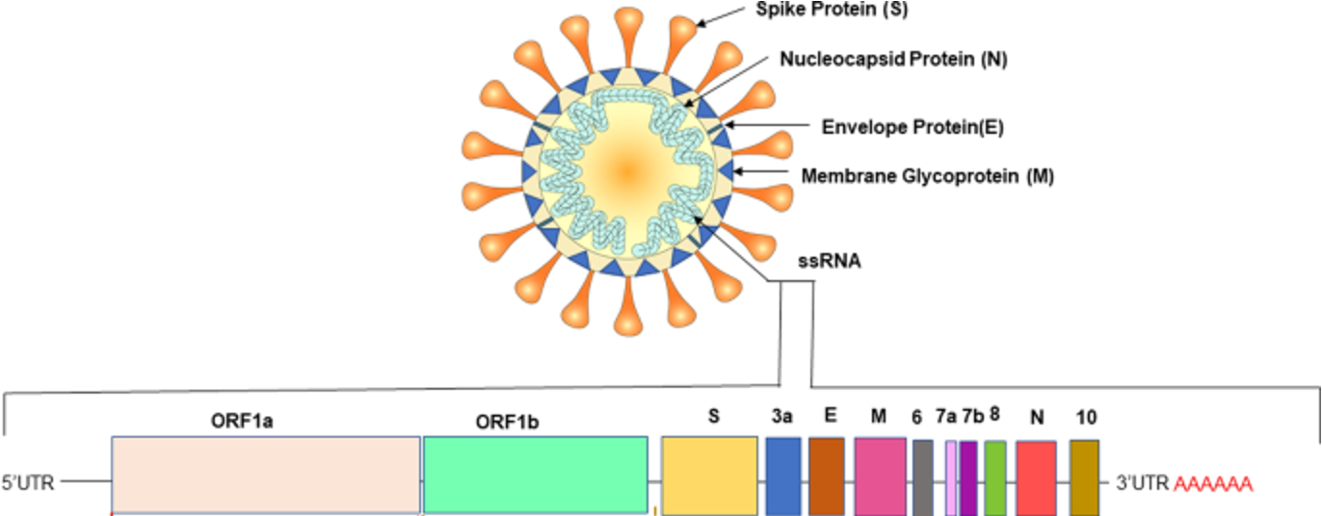
...to here?
Rastogi et al., 2020

Slide 12
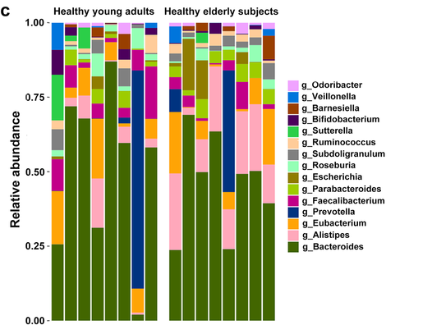
...or here?
Gut Microbiome
Li et al., 2021

Slide 13
Bioinformatic Pipeline Basics

Slide 14
Pipeline Goals
WGS | mNGS
Map reads against a reference genome sequence to obtain a consensus genome | Assign sequencing reads to taxa by comparing sequences against reference databases Assess relative abundance of taxa based on the number of sequences matching a given taxon

Slide 15
Common Pipeline Steps
WGS
Quality control (QC)
Reference-based assembly
Assembly Report

Slide 16
Common Pipeline Steps
WGS
mNGS
Quality control (QC)
QC
Reference-based assembly
Host Filtering
Assembly Report
Duplicate Removal (optional)
Taxonomic Assignment
Taxon Report

Slide 17
Common Pipeline Steps
WGS
mNGS
Quality control (QC)
QC
Reference-based assembly
Host Filtering
Assembly Report
Duplicate Removal (optional)
Taxonomic Assignment
Taxon Report

Slide 18
Common mNGS Pipeline Workflow
Goal: Remove bad quality and uninformative reads
QC
Host Filtering
Duplicate Removal (optional)
Taxonomic Assignment

Slide 19
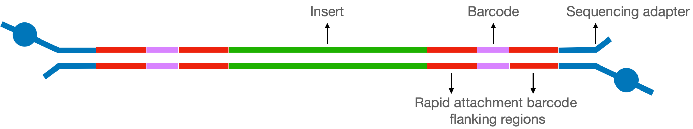
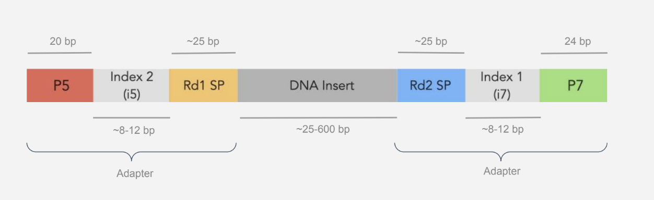
Step 1: Quality Control (QC)
Anatomy of a standard ONT library
Anatomy of a standard Illumina library

Slide 20
Step 1: Quality Control QC
Software to:
  Trim adapters (synthetic, non-genomic)
Why?
Anatomy of a standard ONT library
Adapter
Anatomy of a standard Illumina library

Slide 21
Step 1: Quality Control QC
Software to:
  Trim adapters (synthetic, non-genomic)
Anatomy of a standard ONT library
Anatomy of a standard Illumina library
Adapter
  Filter reads based on quality, complexity, and length
    Quality: Phred score threshold to ensure high quality data
    Complexity: Remove low complexity, repetitive sequences (non-informative)
    Length: Sequence length threshold to remove short sequences

Slide 22
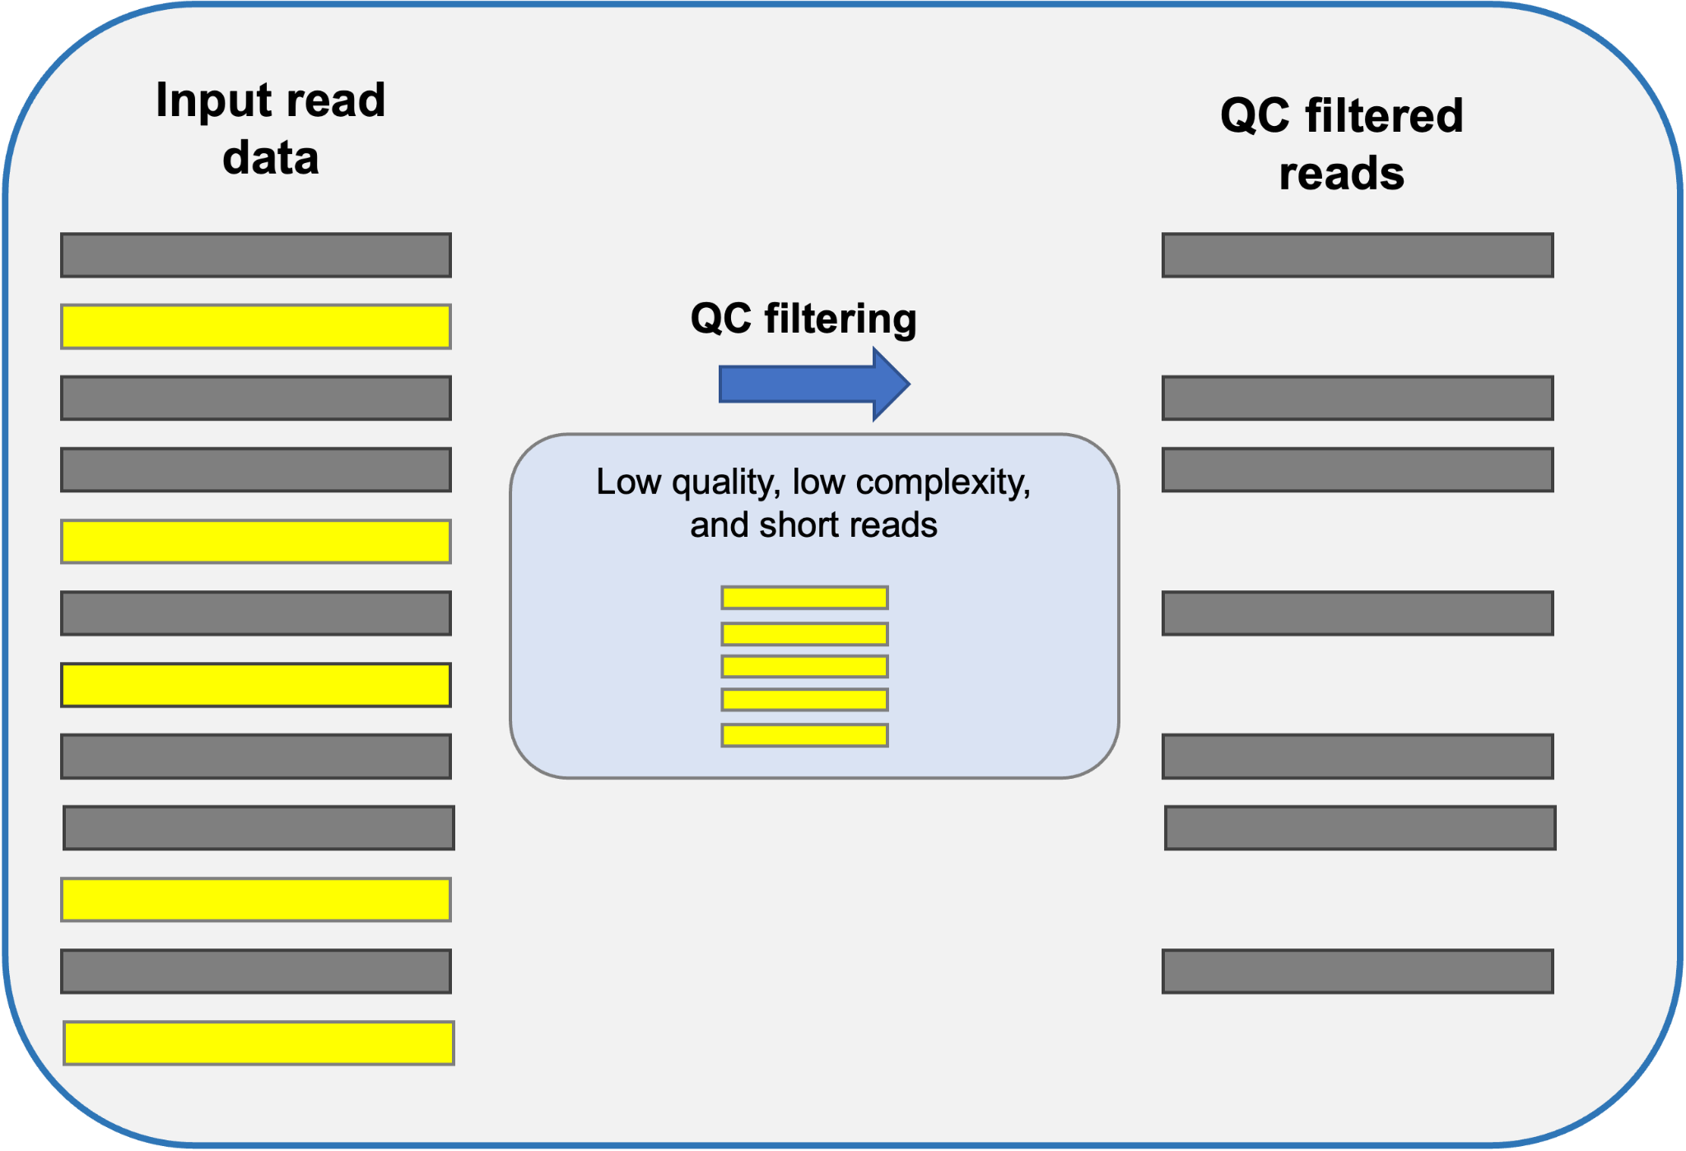
Step 1: QC
Step: Trim adapters and filter reads based on quality (quality scores, complexity, and length)

Slide 23
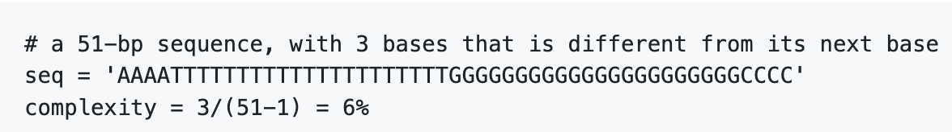
Step 1: QC
Example Software: fastp, Trimmomatic
Example Parameters (fastp):
    Qualified_quality_phred: (i.e., bases with quality scores above a threshold*)
    Unqualified_percent_limit: % of the bases allowed to be unqualified
    Min read length: 35bp (Illumina) 100 (ONT)
    Low_complexity_filter: min % of bases followed by identical base
    N_base_limit: 15 (i.e., discard reads containing
> 15 Ns)
Notes:
Complexity: 30 in illumina 60 in nanopore
Quality: 17 illumina 9 ont

Slide 24
Common mNGS Pipeline Workflow
QC
Goal: Filter out host reads to maximize the microbial signal, reduce false-positives, and protect private information
Host Filtering
Duplicate Removal (optional)
Taxonomic Assignment

Slide 25
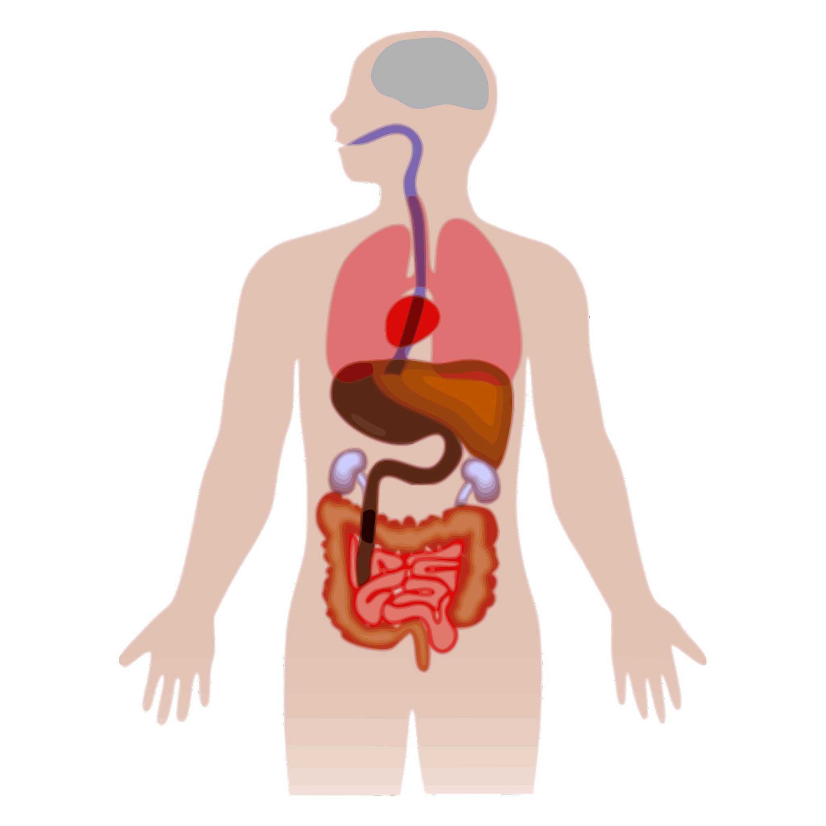
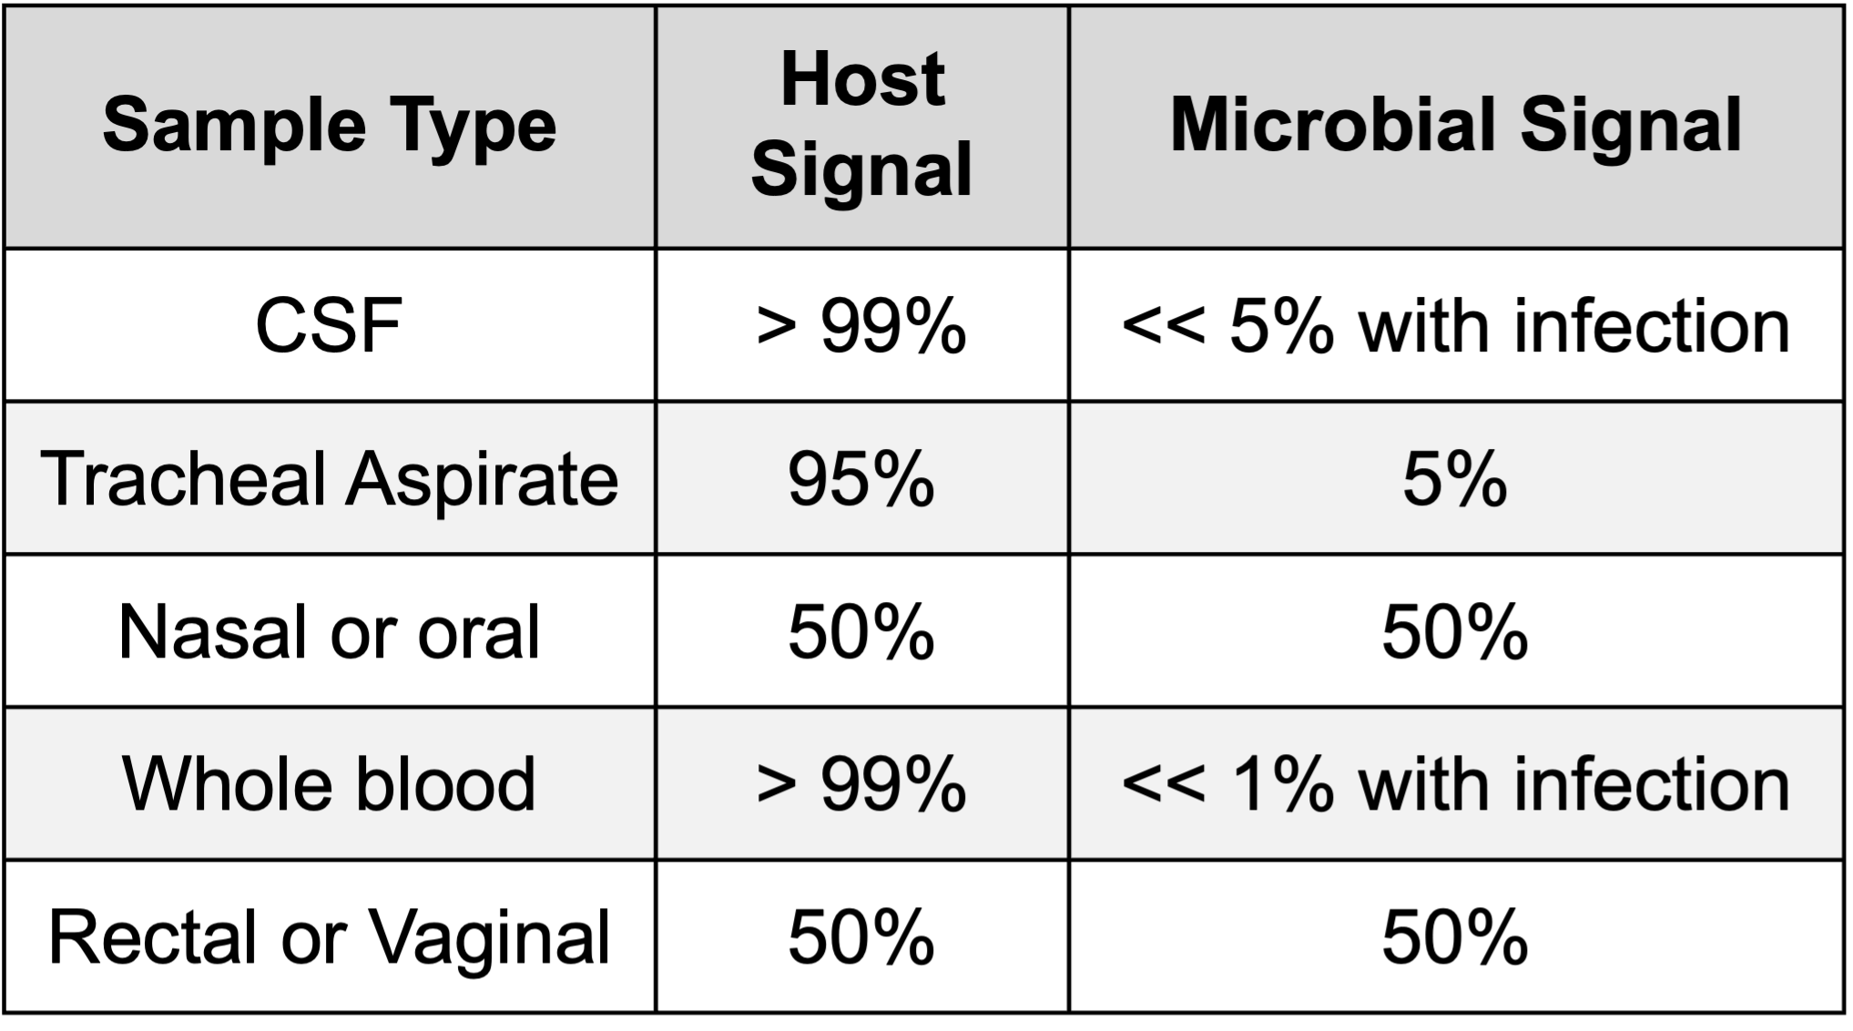
Step 2: Host Filtering
Data may be dominated by host sequences
Host
Microbial
Notes:
Total nucleic acid input, host-to-microbial ratio, and underlying microbial diversity differ significantly across sample types and influence downstream analysis

Slide 26
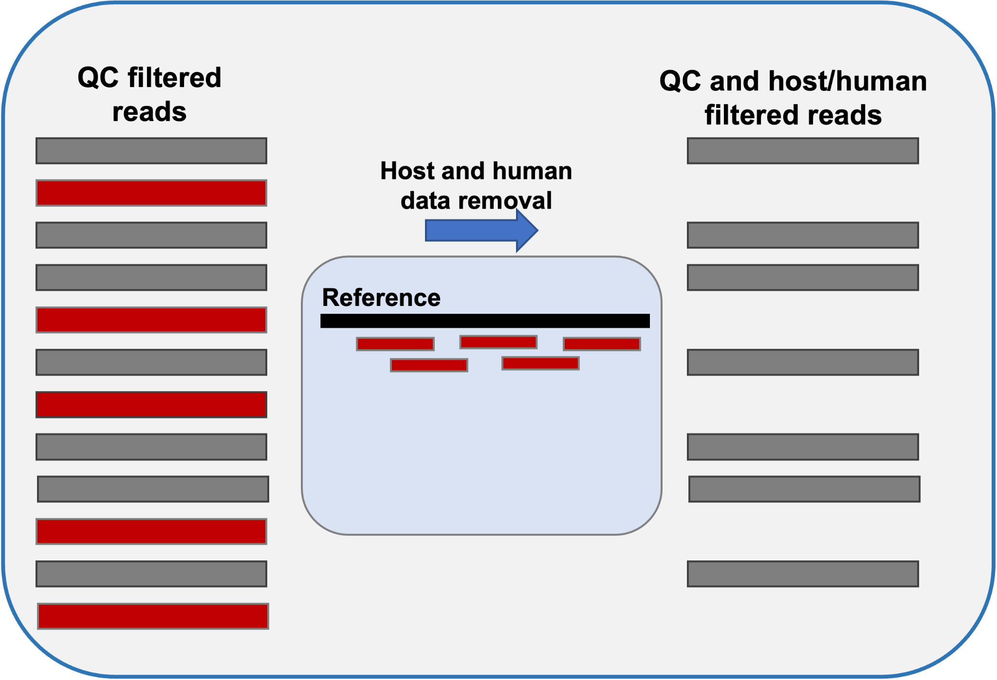
Step 2: Host Filtering
Step: Host read removal through subtractive alignment against reference.

Slide 27
Step 2: Host Filtering
Example Software: Bowtie2, minimap2, HISAT2
Notes:
      Human: Reads mapped against HG38 and/or T2T-CHM13 reference genomes.
      Non-human host: Reads mapped against reference sequence.
      Bowtie2: Optimized for short reads (DNA)
      HISAT2: Optimized for short reads (DNA and RNA)
      Minimap2: Versatile (short- or long-reads, DNA or RNA)
      Samtools can be used to keep reads NOT mapping to the reference genome.

Slide 28
Common mNGS Pipeline Workflow
QC
Host Filtering
Duplicate Removal (optional)
Goal: Cluster duplicate reads to lower computational burden (optional)
Taxonomic Assignment

Slide 29
Step 3: Clustering duplicates
Software to:
    Identify and cluster duplicate sequences (i.e., deduplication)

Slide 30
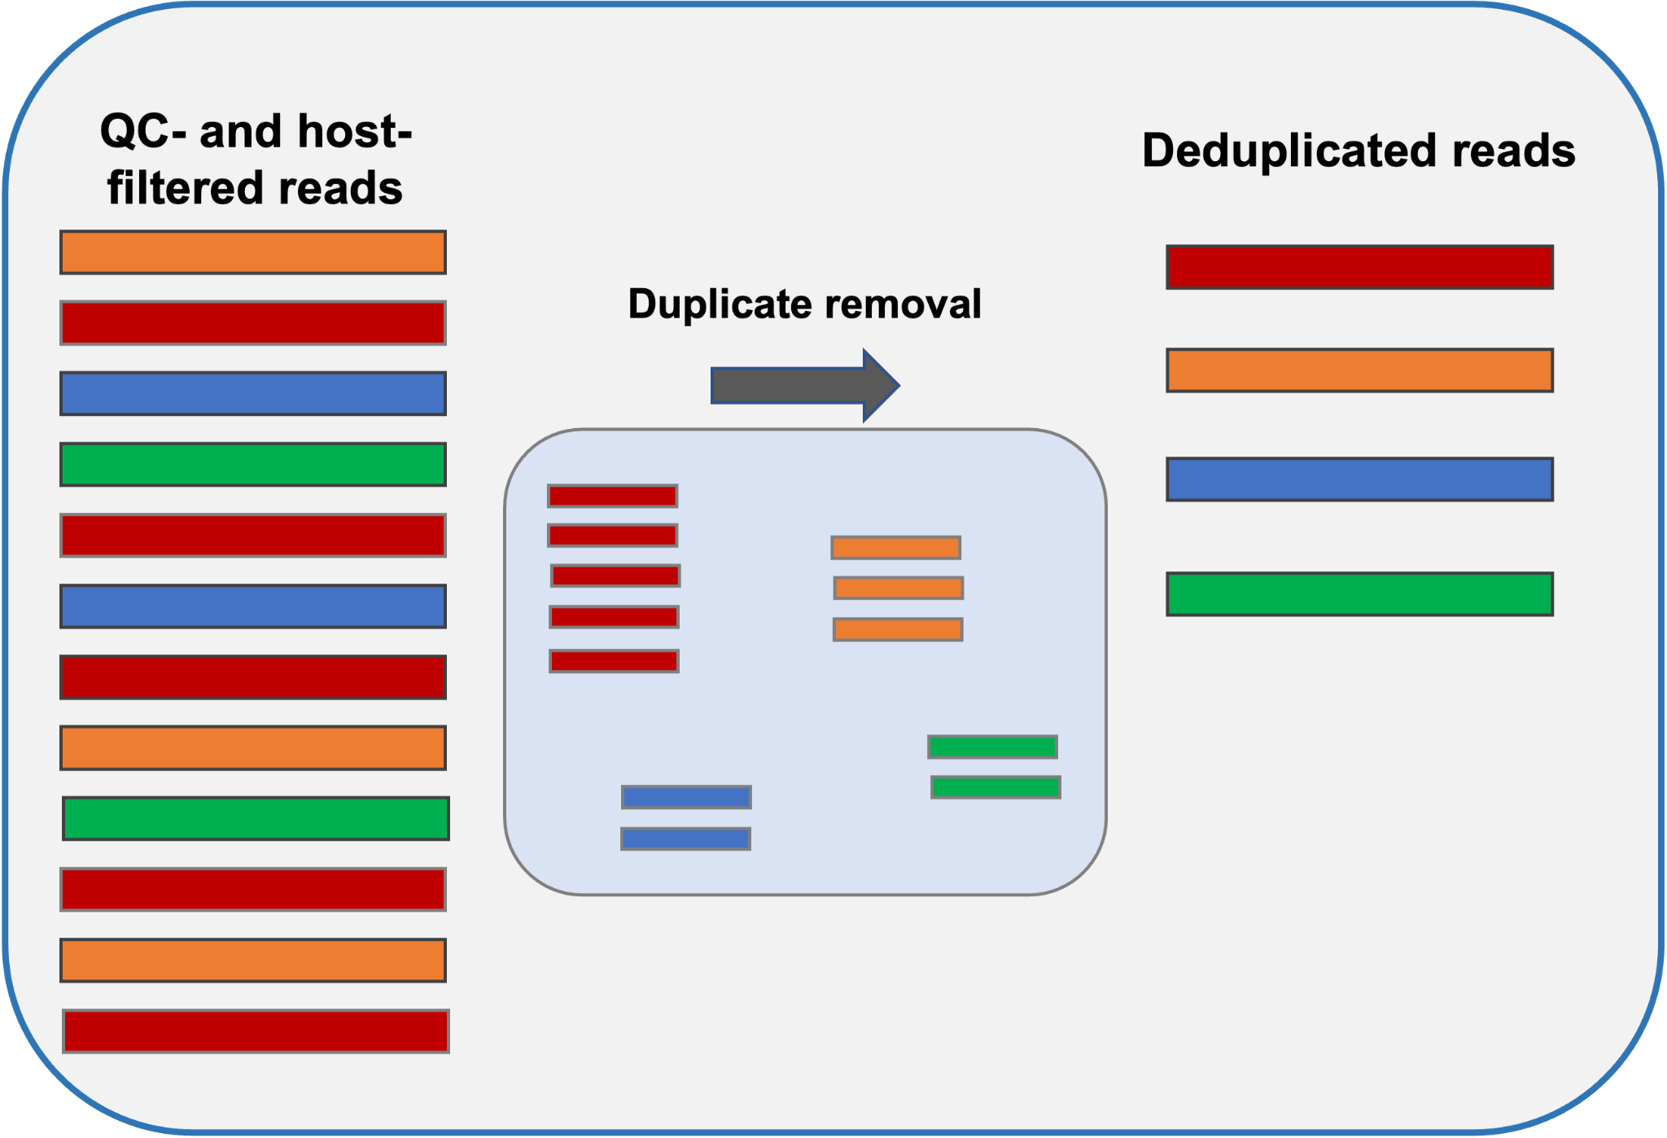
Clustering duplicates
Example Software: CD-HIT-DUP
Notes:
      Reads are clustered based on specified identity threshold and only representative reads from each cluster are used in downstream analysis.
      Cluster information can be retained to calculate non-deduplicated values

Slide 31
Clustering duplicates
Example Software: CD-HIT-DUP
Why calculate non-deduplicated values?
Notes:
      Reads are clustered based on specified identity threshold and only representative reads from each cluster are used in downstream analysis.
      Cluster information can be retained to calculate non-deduplicated values
Notes:
Why calculate non-deduplicated values?
In case of enrichment data such as MSSPE, amplicon, hybridization, or FLASH where duplicates are expected from the enrichment technique

Slide 32
Common mNGS Pipeline Workflow
QC
Host Filtering
Duplicate Removal (optional)
Taxonomic Assignment
Goal: Identify taxa and assess their abundance based on sequence comparisons against a reference database.

Slide 33
Taxonomic Assignment
Software to:
    Compare sequences against a reference database
      k-mer based approaches
      Alignment

Slide 34
Taxonomic assignment:
k-mer based approaches
Goal: Identify query sequences based on the presence of similar substrings (pieces of sequence) in species found in a reference database.

Slide 35
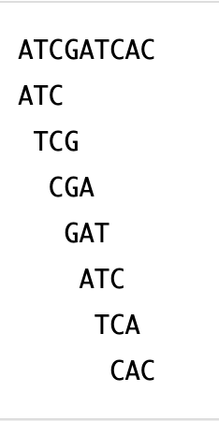
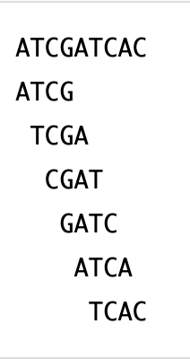
Taxonomic assignment:
k-mer based approaches
Goal: Identify query sequences based on the presence of similar substrings (pieces of sequence) in species found in a reference database.
k-mer: Substring of length k in a given sequence. To get all k-mers from a sequence, get the first k characters and move just a single character to start the next k-mer and so on
3-mers (7)
4-mers (6)
Notes:
Number of k-mers = L - k +1, where L is the length of the sequence and k is the k-mer size

Slide 36
Taxonomic assignment: k-mer based
Example: Kraken2
Kraken:
Taxonomic classification system using exact k-mer matches.
Matches each k-mer within a query sequence to the lowest common ancestor (LCA) of all genomes containing the given k-mer.

Slide 37
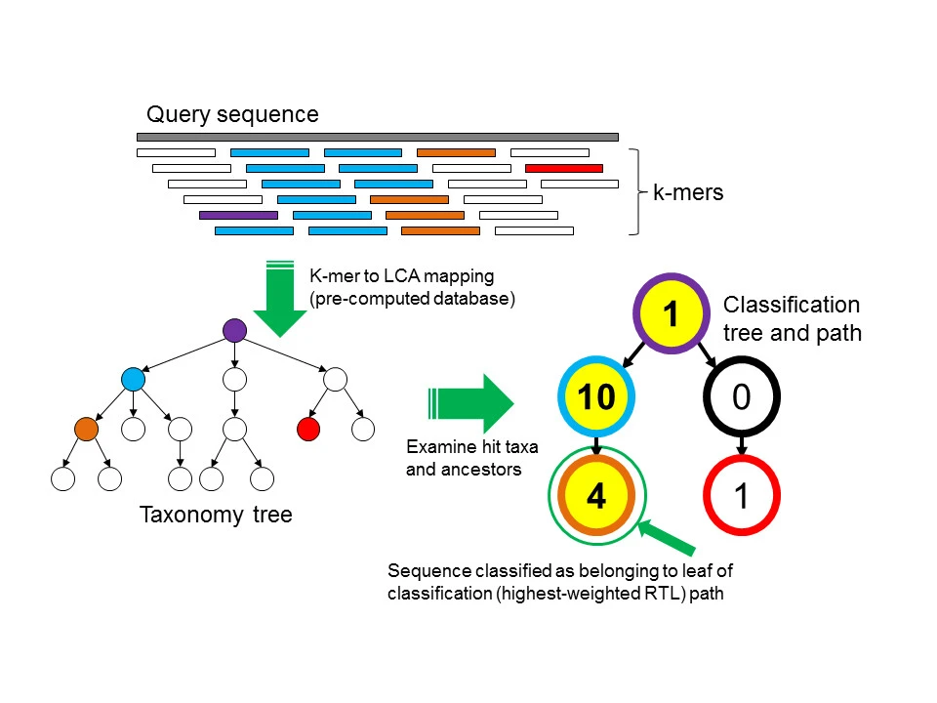
Taxonomic assignment: k-mer based
Example: Kraken2
Extract k-mers from sequence read (31-mers)

Slide 38
Taxonomic assignment: k-mer based
Example: Kraken2
Extract k-mers from sequence read (31-mers)
2. Compare to pre-computed database to determine taxonomic ID of reference sequences with specified k-mer (Lowest Common Ancestor, LCA, mapping)

Slide 39
LCA Mapping
Enterobacteriaceae
Klebsiella
Citrobacter
Salmonella
K. pneumoniae
K. oxytoca
K. granulomatis
C. freundii
S. enterica
S. bongori
Taxonomy

Slide 40
LCA Mapping
Enterobacteriaceae (1)
Klebsiella
Citrobacter
Salmonella
K. pneumoniae
K. oxytoca
K. granulomatis
C. freundii
S. enterica
S. bongori
Taxonomy

Slide 41
LCA Mapping
Enterobacteriaceae (1)
Klebsiella
Citrobacter
Salmonella
K. pneumoniae
K. oxytoca
K. granulomatis
C. freundii
S. enterica
S. bongori
Taxonomy

Slide 42
LCA Mapping
Enterobacteriaceae (1)
Klebsiella (10)
Citrobacter
Salmonella
K. pneumoniae
K. oxytoca
K. granulomatis
C. freundii
S. enterica
S. bongori
Taxonomy

Slide 43
LCA Mapping
Enterobacteriaceae (1)
Klebsiella (10)
Citrobacter
Salmonella
K. pneumoniae (4)
K. oxytoca
K. granulomatis
C. freundii
S. enterica (1)
S. bongori
Taxonomy

Slide 44
Taxonomic assignment: k-mer based
Example: Kraken2
Extract k-mers from sequence read (31-mers)
2. Compare to pre-computed database to determine taxonomic ID of reference sequences with specified k-mer (Lowest Common Ancestor, LCA, mapping)
Notes:
matches each k-mer within a query sequence to the lowest common ancestor (LCA) of all genomes containing the given k-mer

Slide 45
Taxonomic assignment: k-mer based
Example: Kraken2
Extract k-mers from sequence read (31-mers)
2. Compare to pre-computed database to determine taxonomic ID of reference sequences with specified k-mer (Lowest Common Ancestor, LCA, mapping)
3. Use subtree for classification. Find path with maximum sum and report taxonomic level for leaf
K. pneumoniae
Notes:
matches each k-mer within a query sequence to the lowest common ancestor (LCA) of all genomes containing the given k-mer

Slide 46
Taxonomic assignment
Software to:
    Compare sequences against a reference database
      k-mer based approaches (fast, simplify data processing to counting k-mers and comparing whether they are shared)
      Alignment
Notes:
Good post for understanding k-mers: https://bioinfologics.github.io/post/2018/09/17/k-mer-counting-part-i-introduction/

Slide 47
Taxonomic assignment: Alignment
Alignment goal: Align unknown (query) sequences against a database of known sequences to identify the microbe of origin.
Database searching occurs through pairwise, local alignments against sequences found in the database

Slide 48
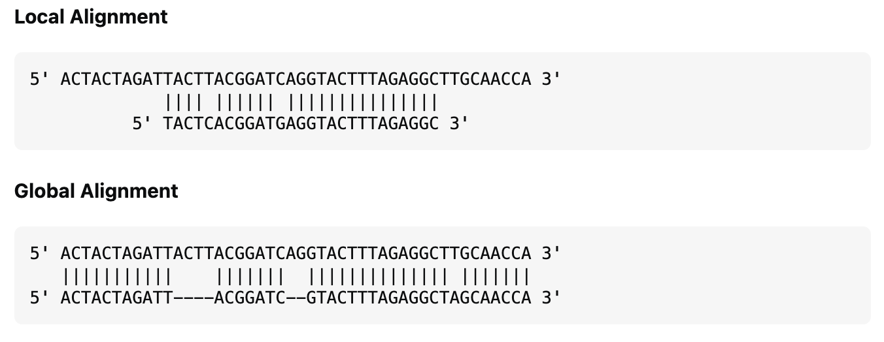
Taxonomic assignment: Alignment
Alignment goal: Query unknown sequences against a database of known sequences to identify the microbe of origin.
Database searching: Pairwise, local alignments against sequences found in the database
Global Alignment
End-to-end
Local Alignment
Substring

Slide 49
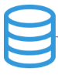
Taxonomic assignment: Alignment
Query: Unknown sequence
Database of known sequences
> Seq_1, unknown
CTCATTCGGT
> species A
GCCTCGATCTGTAGCCT
> species B
ATGGACTCATTCGGTCG
> species C
TGCTAAATCGCGCCCTA
> species D
TGGCTAAGTCATATAGC

Slide 50
Taxonomic assignment: Alignment
Query: Unknown sequence
Database of known sequences
Sequence Alignment
> Seq_1, unknown
CTCATTCGGT
> species A
GCCTCGATCTGTAGCCT
> species B
ATGGACTCATTCGGTCG
> species C
TGCTAAATCGCGCCCTA
> species D
TGGCTAAGTCATATAGC
> species A
GCCTCGATCTGTAGCCT
||| | ||
CTCATTCGGT
> species B
ATGGACTCATTCGGTCG
||||||||||
CTCATTCGGT
> species C
TGCTAAATCGCGCCCTA
|| | |||
CTCATTCGGT
> species D
TGGCTAAGTCATATAGC
|||| |
CTCATTCGGT

Slide 51
Taxonomic assignment: Alignment
Query: Unknown sequence
Database of known sequences
Sequence Alignment
> Seq_1, unknown
CTCATTCGGT
> species A
GCCTCGATCTGTAGCCT
> species B
ATGGACTCATTCGGTCG
> species C
TGCTAAATCGCGCCCTA
> species D
TGGCTAAGTCATATAGC
> species A
GCCTCGATCTGTAGCCT
||| | ||
CTCATTCGGT
> species B
ATGGACTCATTCGGTCG
||||||||||
CTCATTCGGT
> species C
TGCTAAATCGCGCCCTA
|| | |||
CTCATTCGGT
> species D
TGGCTAAGTCATATAGC
|||| |
CTCATTCGGT
Seq_1 = Species B

Slide 52
Alignment Metrics
Alignment length
  How long is the alignment between the query and subject (sequence in the database)?

Slide 53
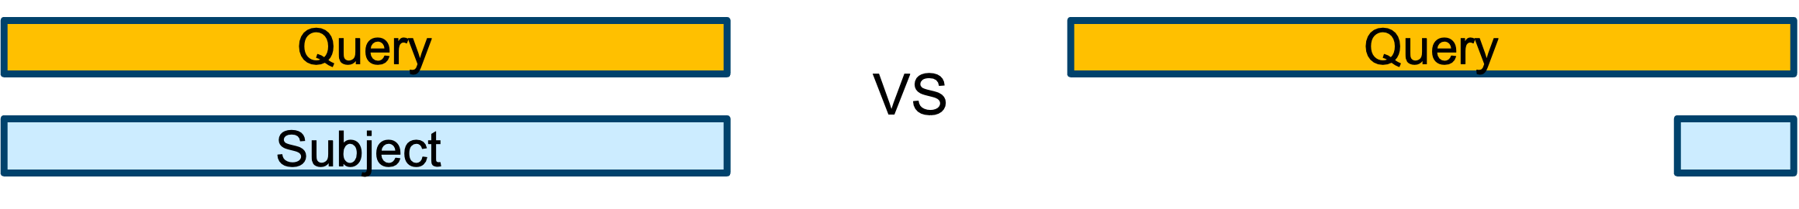
Alignment Metrics
Alignment length
  How long is the alignment between the query and subject (sequence in the database)?
Query coverage
  How much of my query sequence was covered by the alignment?

Slide 54
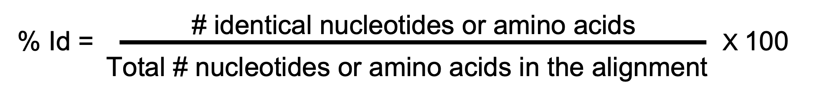
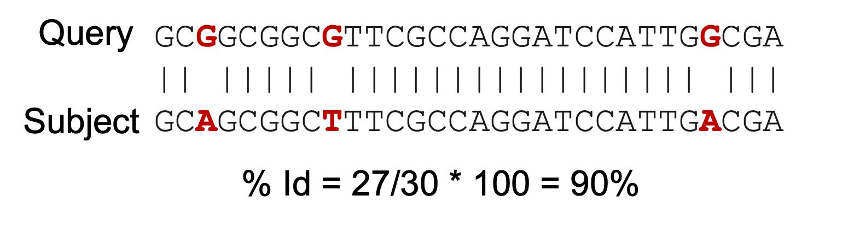
Alignment Metrics
Alignment length
  How long is the alignment between the query and subject (sequence in the database)?
Query coverage
  How much of my query sequence was covered by the alignment?
Percent identity (% Id)
  How similar is my query sequence to the subject sequence?

Slide 55
Taxonomic assignment: Alignment
Alignment goal: Align unknown sequences against a database of known sequences to identify the microbe of origin.
Query:
  Reads: Quality- and host- filtered sequence reads
  Contigs: Assembled or merged sequence reads that form longer DNA sequences.

Slide 56
Contigs
Contigs: Assembled or merged sequence reads that form longer DNA sequences. The assembly aims to reconstruct the original sequence.
Microbial Genome Sequence
Sequencing Reads
Assembled Contigs

Slide 57
Sequence Assembly
Assembly goal: Merge sequence reads into contigs to form longer DNA sequences and reconstruct the original sequence
Microbial Genome Sequence
(Sample)

Slide 58
Sequence Assembly
Assembly goal: Merge sequence reads into contigs to form longer DNA sequences and reconstruct the original sequence
Microbial Genome Sequence
Sequencing Reads

Slide 59
Sequence Assembly
Assembly goal: Merge sequence reads into contigs to form longer DNA sequences and reconstruct the original sequence
Microbial Genome Sequence
Sequencing Reads
Assembled Contigs

Slide 60
Sequence Assembly
Assembly goal: Merge sequence reads into contigs to form longer DNA sequences and reconstruct the original sequence
Microbial Genome Sequence
Sequencing Reads
Assembled Contigs
ATGGACTCATTCGGTCG
TGATAGTTCCTAGATAC
TCGAATAGTAGCCTGAT
ATGGACTCATTCGGTCGAATAGTAGCCTGATAGTTCCTAGATAC

Slide 61
Assembly
Software: SPAdes, Flye, MetaFlye
Step: Contig assembly
Sequencing Reads
Notes:
      Input: preprocessed reads in FASTA or FASTQ format
      Assembly choices based on the type of data (e.g., DNA vs RNA, WGS vs mNGS)
      .
De novo assembly
Assembled Contigs

Slide 62
Taxonomic assignment: Alignment
Alignment goal: Query unknown sequences against a database of known sequences to identify the microbe of origin.
Query: Reads or Contigs
If you could do anything (compute resources are not an issue), what would you use as a query?

Slide 63
Taxonomic assignment: Alignment
Alignment goal: Query unknown sequences against a database of known sequences to identify the microbe of origin.
Query: Reads and/or Contigs
Database: Any reference database of known organism sequences. Databases from the National Center for Biotechnology Information (NCBI) are ideal because they include comprehensive collections of publicly available sequences.

Slide 64
NCBI Databases
GenBank: Includes a collection of all publicly available DNA sequences. Researches directly submit sequences to GenBank where the data goes through automated and manual processing to ensure data integrity (otherwise, the data is not curated).
RefSeq: Curated subset from GenBank. Curation ensures high accuracy and reliability.

Slide 65
NCBI Databases
 | NT Database | NR Database
Definition | NT = nucleotide | NR = non-redundant protein

Slide 66
NCBI Databases
 | NT Database | NR Database
Definition | NT = nucleotide | NR = non-redundant protein
What is in the database? | Publicly available nucleotide sequences (GenBank sequences except for sequences from NGS projects, such as WGS and SRA databases). | Amino acid sequences representing non-redundant, annotated coding regions from GenBank as well as records from protein databases (e.g., UniProt and PDB). Note: does not contain rRNA sequences given that these do not encode proteins

Slide 67
NCBI reference databases
 | NT Database | NR Database
Definition | NT = nucleotide | NR = non-redundant protein
What is in the database? | Publicly available nucleotide sequences (GenBank sequences except for those from NGS projects, such as WGS and SRA databases). | Amino acid sequences representing non-redundant, annotated coding regions from GenBank as well as records from protein databases (e.g., UniProt and PDB). Note: does not contain rRNA sequences (do not encode proteins)
How does it influence analysis? | NT alignments tend to be more accurate for most organisms (bacteria, eukaryotes, known viruses) | NR alignments are especially good for detecting divergent viruses, given that mutations in the NT sequence accumulate faster than the amino acid sequence

Slide 68
Amino Acid vs Nucleotide Alignments
Species 1
V I V A E L M A T E Y V L I V I A
100 % Id
Species 2
V I V A E L M A T E Y V L I V I A

Slide 69
Amino Acid vs Nucleotide Alignments
Species 1
V I V A E L M A T E Y V L I V I A
100 % Id
Species 2
V I V A E L M A T E Y V L I V I A
Sp. 1
GTG ATA GTA GCT GTC TTG ATC GTG ATC GCA TAT GAA CTG ATG GCT ACG GAA
Sp. 2
GTG ATA GTG GCC GTC TTG ATA GTG ATC GCG TAT GAA CTA ATG GCA ACG GAA

Slide 70
Amino Acid vs Nucleotide Alignments
Species 1
V I V A E L M A T E Y V L I V I A
100 % Id
Species 2
V I V A E L M A T E Y V L I V I A
88 % Id
Sp. 1
GTG ATA GTA GCT GTC TTG ATC GTG ATC GCA TAT GAA CTG ATG GCT ACG GAA
Sp. 2
GTG ATA GTG GCC GTC TTG ATA GTG ATC GCG TAT GAA CTA ATG GCA ACG GAA

Slide 71
Where would you see the following E. coli matches?
E. coli 16S rRNA
 | NT Database | NR Database
Match (or hit) to E. coli based on…

Slide 72
Where would you see the following E. coli matches?
E. coli polymerase
 | NT Database | NR Database
Match (or hit) to E. coli based on…

Slide 73
Where would you see the following E. coli matches?
E. coli polymerase
E. coli 16S rRNA
 | NT Database | NR Database
Match (or hit) to E. coli based on… | 16S rRNA Polymerase | Polymerase

Slide 74
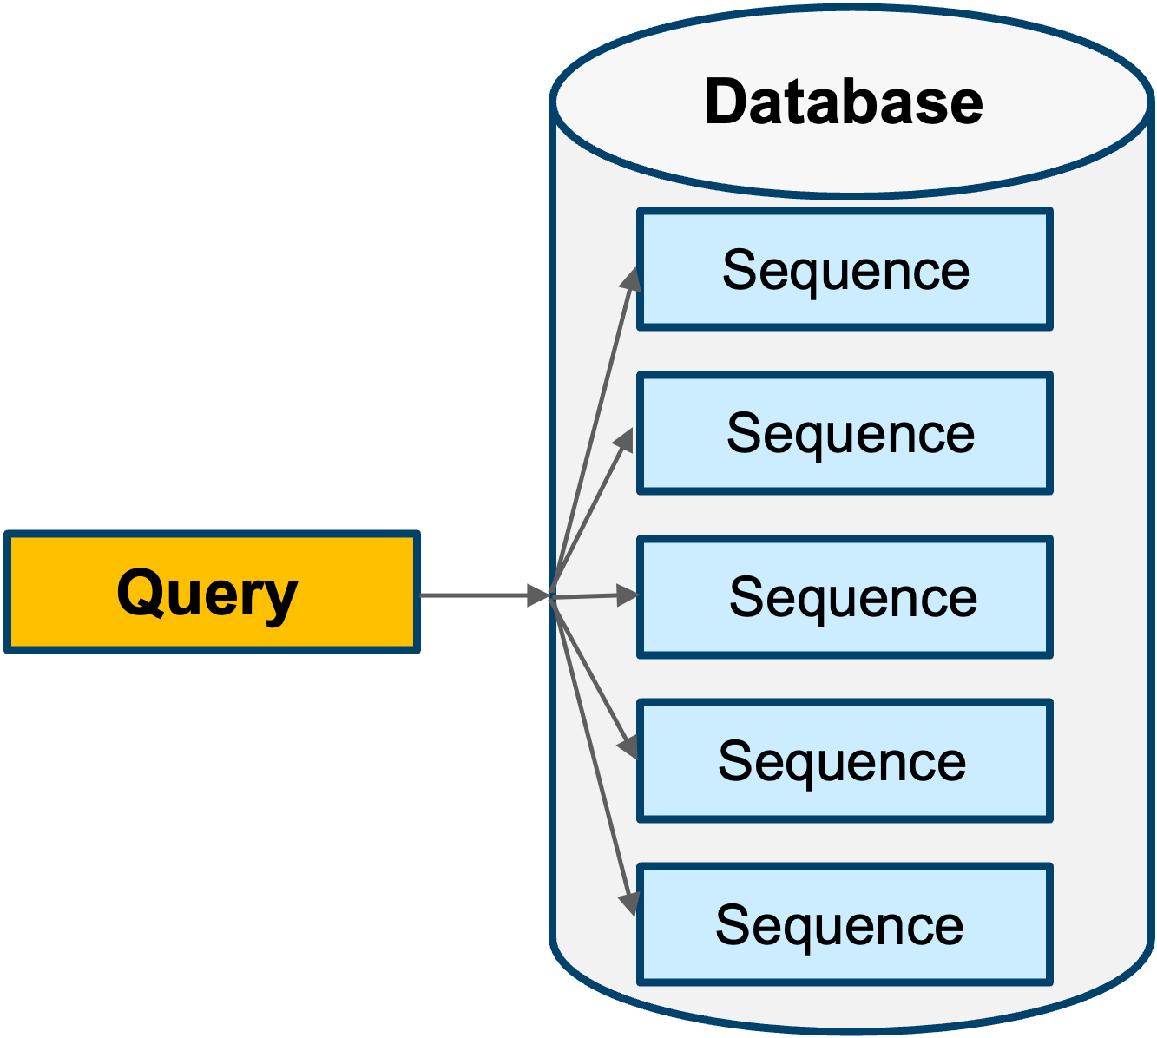
Taxonomic assignment
Example software: BLAST, minimap2, Kraken2, DIAMOND
Step: Querying reference database
Notes:
BLAST – aligns nucleotide and amino acid sequences
Minimap2 – aligns nucleotide sequences
Kraken2 - kmer-based approach for searching nucleotide and amino acid sequences
DIAMOND – aligns amino acid sequences
      .

Slide 75
Common mNGS Pipeline Steps
QC
Host Filtering
Duplicate Removal (optional)
Assembly
Taxonomic Assignment
Report

Slide 76
Basic Local Alignment Search Tool (BLAST)
Gold standard tool for sequence similarity searching against databases (sensitive!)

Slide 77
Basic Local Alignment Search Tool (BLAST)
Gold standard tool for sequence similarity searching against databases (sensitive!)
Provides alignment metrics to evaluate the significance of alignments
  Bit score: Metric derived from the raw alignment score. The higher the bit score, the more significant the alignment (higher similarity).
  E-value: Number of matches you expect to see by chance. The lower the E-value, the more significant the alignment.

Slide 78
Basic Local Alignment Search Tool (BLAST)
Gold standard tool for sequence similarity searching against databases (sensitive!)
Provides alignment metrics to evaluate the significance of alignments
  Bit score
  E-value
Great resource for genomic applications
  Finding similar sequences
  Identifying unknown sequences (taxonomy)
  Genome annotation

Slide 79
Basic Local Alignment Search Tool (BLAST)
Gold standard tool for sequence similarity searching against databases (sensitive!)
Provides alignment metrics to evaluate the significance of alignments
  Bit score
  E-value
Great resource for genomic applications
  Finding similar sequences
  Identifying unknown sequences (taxonomy)
  Genome annotation
Limitation: Time required for alignment scales with query and database length

Slide 80

Let’s BLAST!
Activity: BLAST

